Slide 1
Receipt Image Processing
Course Project

Slide 2
Project Intro
General goal
Approach to the problem
Process the receipt photo by removing all irrelevant details (mainly the background), leaving only the receipt visible.
It looks like an object detection or segmentation problem.
In one of the classes, the Facebook segmentation model "SAM" was shown, so I’ve decided to experiment with it .

Slide 3
Script pipeline overview
120
2
300
Make a photo of the receipt
Convert the image into the format acceptable for OpenCV
Resize the photo to have 320 pixels
Run SAM model on the resized image and obtain receipt mask
0.5
72
7
149
Identify corners on the mask
Define bounding box for original image size
Crop the receipt
Save the results
execution time for 435 img in seconds

Slide 4
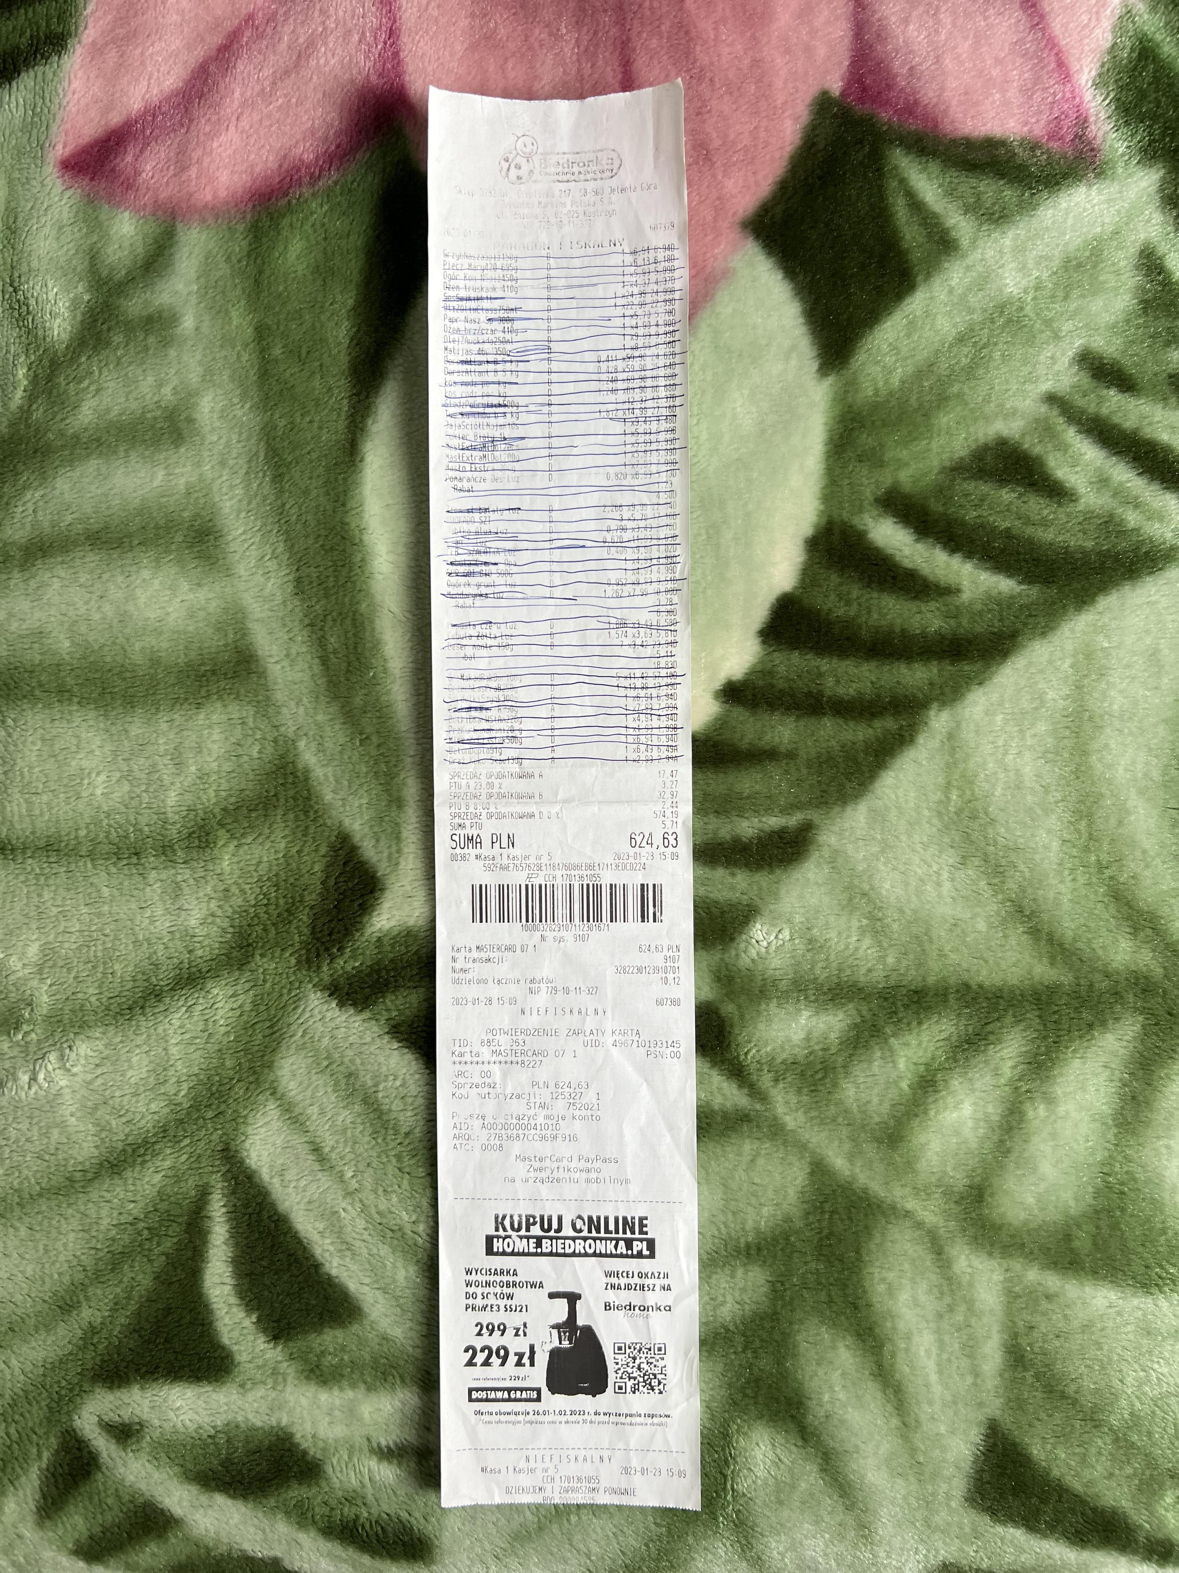
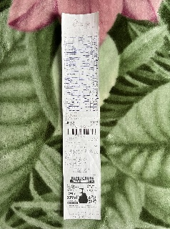


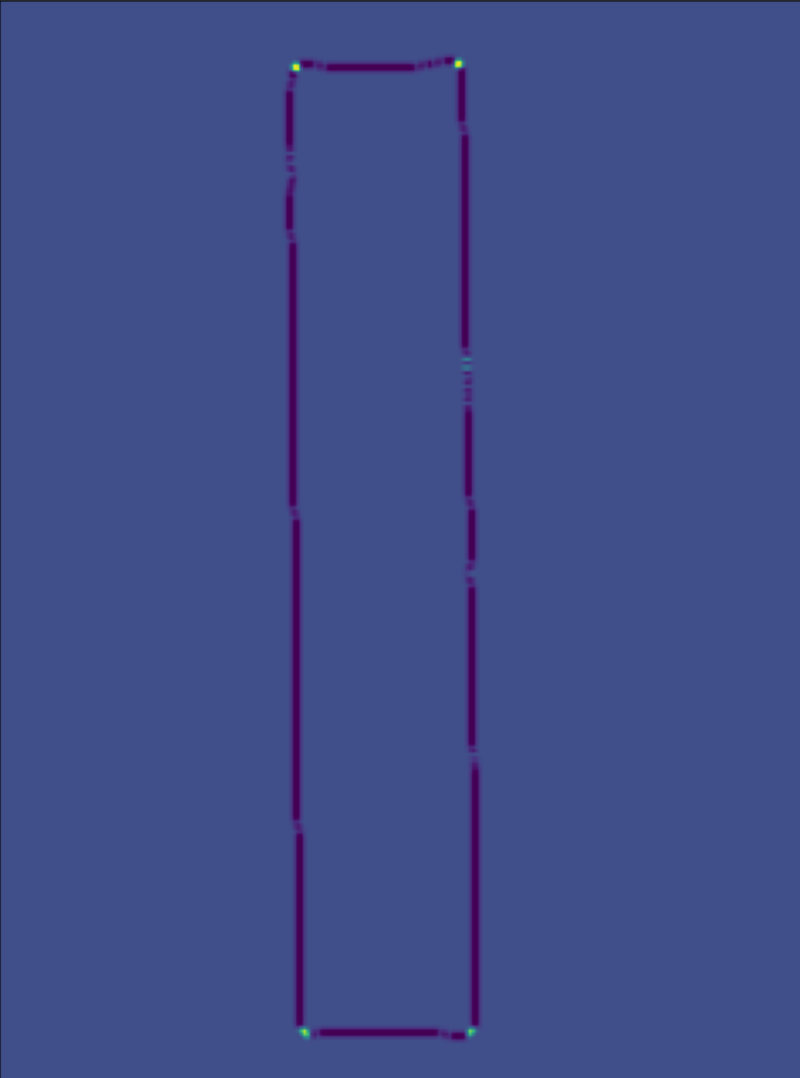
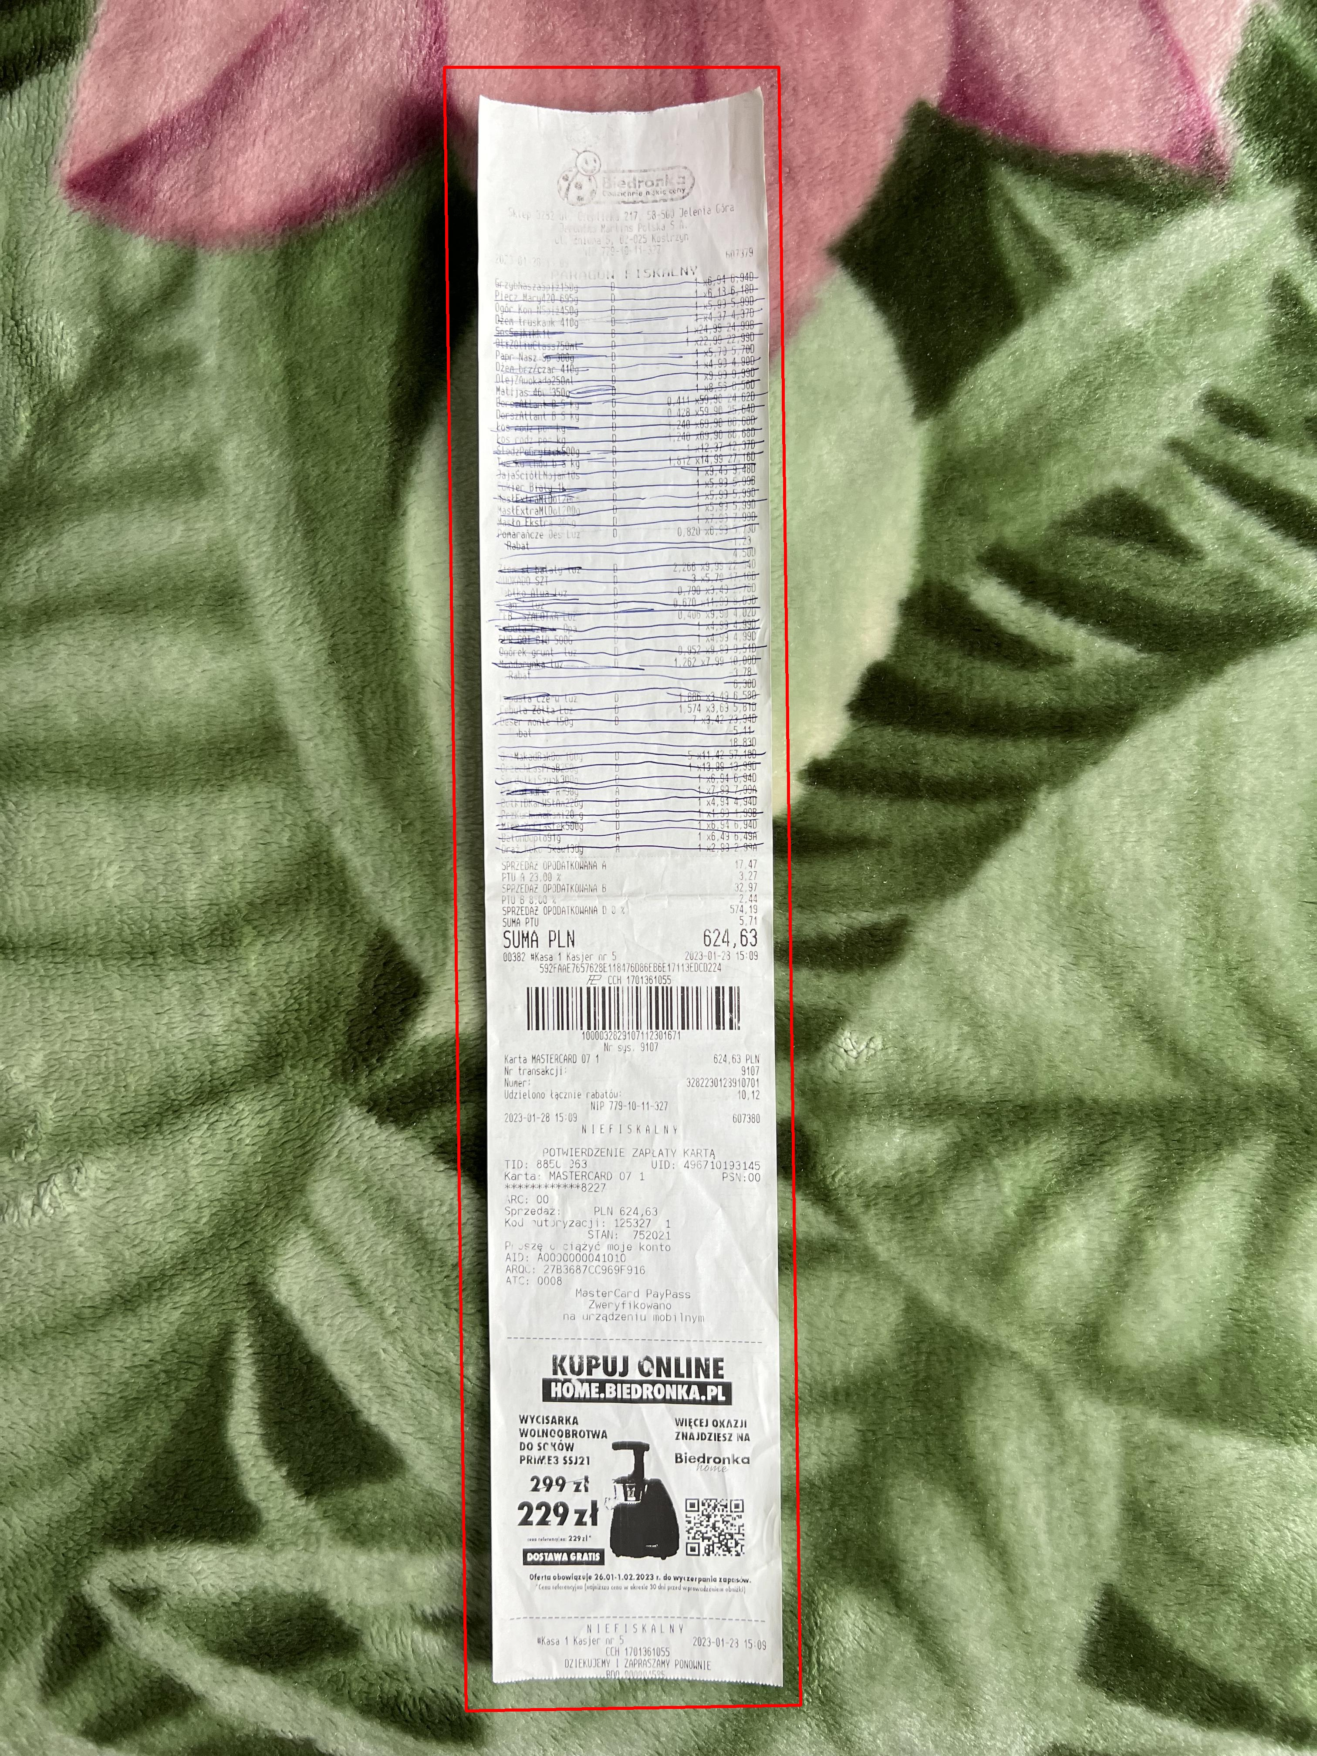
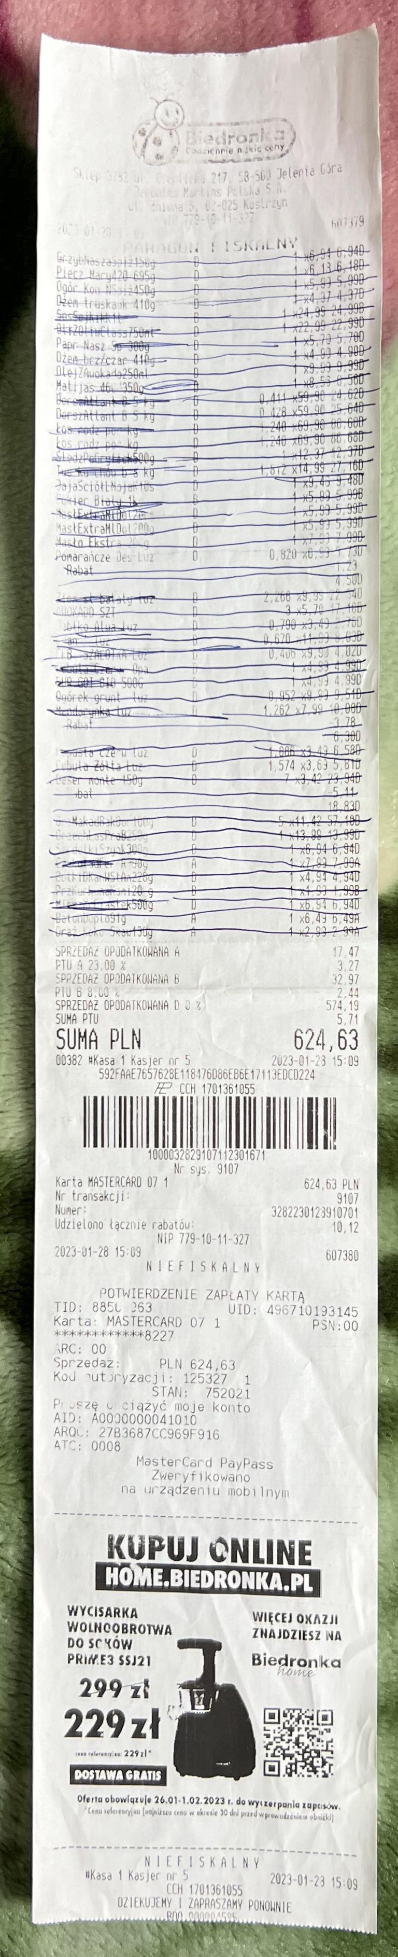
Script results
Original Image
Resized Image
ROI for SAM
SAM mask
Corner map
Bounding box
Cropped receipt

Slide 5

Summary
Image processed: 435
Imaged processed successfully: 432
Success rate: 99.31%
Approximate execution speed per image: ~2 seconds
Further steps
Improve execution speed
Improve ROI identification code block
Improve bounding box calculation code block
Introduce additional pipeline that could identify image deformations after applying warp perspective

